Slide 1
안드로이드 실무 6주차 과제
1901055 정시철

Slide 2
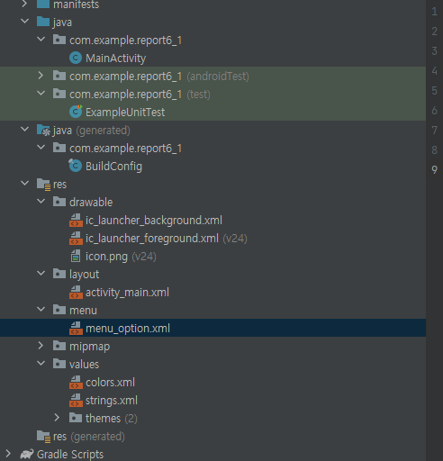
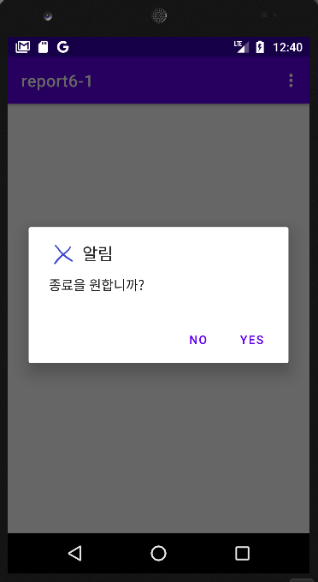
Report 1 기본 알림 메시지
<?xml version="1.0" encoding="utf-8"?> <LinearLayout xmlns:android="http://schemas.android.com/apk/res/android" xmlns:tools="http://schemas.android.com/tools" android:layout_width="match_parent" android:layout_height="match_parent" android:orientation="vertical" android:gravity="center" tools:context=".MainActivity"> <TextView android:layout_width="wrap_content" android:layout_height="wrap_content" android:text="Option Menu의 Alert Dialog 예제 입니다."/> </LinearLayout>
package com.example.report6_1; import androidx.annotation.NonNull; import androidx.appcompat.app.AlertDialog; import androidx.appcompat.app.AppCompatActivity; import android.content.DialogInterface; import android.os.Bundle; import android.view.Menu; import android.view.MenuInflater; import android.view.MenuItem; import android.widget.Toast; public class MainActivity extends AppCompatActivity { private long backKeyPressedTime = 0; private Toast toast; @Override protected void onCreate(Bundle savedInstanceState) { super.onCreate(savedInstanceState); setContentView(R.layout.activity_main); } @Override public boolean onCreateOptionsMenu(Menu menu) { MenuInflater inflater = getMenuInflater(); inflater.inflate(R.menu.menu_option, menu); return super.onCreateOptionsMenu(menu); } @Override public boolean onOptionsItemSelected(@NonNull MenuItem item) { if(item.getItemId()==R.id.exit){ AlertDialog.Builder builder = new AlertDialog.Builder(this); builder.setIcon(R.drawable.icon); builder.setTitle("알림"); builder.setMessage("종료을 원합니까?"); builder.setPositiveButton("Yes", new DialogInterface.OnClickListener() { @Override public void onClick(DialogInterface dialogInterface, int i) { finish(); } }); builder.setNegativeButton("No", new DialogInterface.OnClickListener() { @Override public void onClick(DialogInterface dialog, int which) { dialog.cancel(); } }); AlertDialog alertDialog=builder.create(); alertDialog.show(); } return super.onOptionsItemSelected(item); } @Override public void onBackPressed() { if (System.currentTimeMillis() > backKeyPressedTime + 2500) { backKeyPressedTime = System.currentTimeMillis(); toast = Toast.makeText(this, "Back Button을 눌렀다.", Toast.LENGTH_SHORT); toast.show(); return; } } }
<?xml version="1.0" encoding="utf-8"?> <menu xmlns:app="http://schemas.android.com/apk/res-auto" xmlns:android="http://schemas.android.com/apk/res/android"> <item android:id="@+id/exit" android:title="Exit" app:showAsAction="never"> </item> </menu>

Slide 3
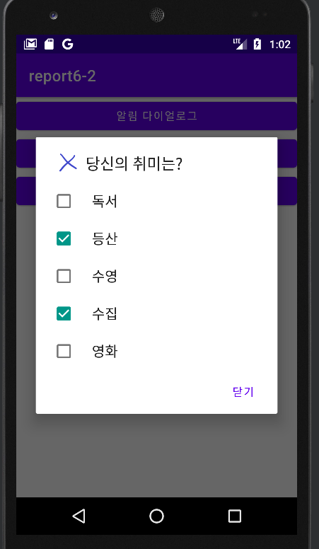
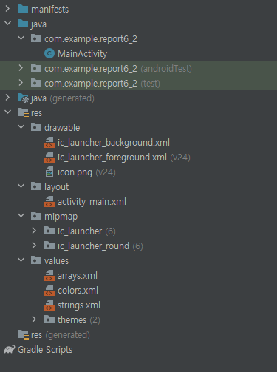
Report 2 종류별 다이어로그 3개
package com.example.report6_2; import androidx.appcompat.app.AppCompatActivity; import android.app.AlertDialog; import android.content.DialogInterface; import android.os.Bundle; import android.text.InputType; import android.view.View; import android.widget.EditText; import android.widget.Toast; import java.util.ArrayList; import java.util.List; public class MainActivity extends AppCompatActivity { private String myname; private List<String> list; @Override protected void onCreate(Bundle savedInstanceState) { super.onCreate(savedInstanceState); setContentView(R.layout.activity_main); } public void onclick(View view) { AlertDialog.Builder builder = new AlertDialog.Builder(MainActivity.this); builder.setIcon(R.drawable.icon); builder.setTitle("알림"); builder.setMessage("이번주 레포트는 Dialog 입니다."); builder.setPositiveButton("확인", new DialogInterface.OnClickListener() { @Override public void onClick(DialogInterface dialogInterface, int i) { Toast.makeText(MainActivity.this, "확인했습니다.", Toast.LENGTH_SHORT).show(); }}); AlertDialog dialog = builder.create(); dialog.show(); } public void onclick1(View view) { final EditText editText = new EditText(MainActivity.this); editText.setInputType(InputType.TYPE_CLASS_TEXT); AlertDialog.Builder builder = new AlertDialog.Builder(MainActivity.this); builder.setIcon(R.drawable.icon); builder.setTitle("이름 입력"); builder.setView(editText); builder.setPositiveButton("확인", new DialogInterface.OnClickListener() { @Override public void onClick(DialogInterface dialog, int i) { myname = editText.getText().toString(); if(myname.equals("")){ Toast.makeText(MainActivity.this, "입력해주세요.", Toast.LENGTH_SHORT).show(); } else { Toast.makeText(MainActivity.this, myname, Toast.LENGTH_SHORT).show(); } }}); AlertDialog dialog = builder.create(); dialog.show(); } public void onclick2(View view) { list=new ArrayList<>(); AlertDialog.Builder builder = new AlertDialog.Builder(this); builder.setIcon(R.drawable.icon); builder.setTitle("당신의 취미는?"); builder.setMultiChoiceItems(R.array.lists, null, new DialogInterface.OnMultiChoiceClickListener() { @Override public void onClick(DialogInterface dialog, int which, boolean isChecked) { String arr[]=getResources().getStringArray(R.array.lists); if(isChecked){ list.add(arr[which]); } else if(list.contains(arr[which])){ list.remove(arr[which]); } }}); builder.setPositiveButton("닫기", new DialogInterface.OnClickListener() { @Override public void onClick(DialogInterface dialogInterface, int i) { if(list.size() == 0){ Toast.makeText(MainActivity.this, "취미를 선택하세요.", Toast.LENGTH_SHORT).show(); } else { String data=""; for(String item:list){ data=data+item; } Toast.makeText(MainActivity.this, "취미 : " +data, Toast.LENGTH_SHORT).show(); } }}); AlertDialog dialog = builder.create(); dialog.show(); } }
<?xml version="1.0" encoding="utf-8"?> <LinearLayout xmlns:android="http://schemas.android.com/apk/res/android" xmlns:tools="http://schemas.android.com/tools" android:layout_width="match_parent" android:layout_height="match_parent" android:orientation="vertical" tools:context=".MainActivity"> <Button android:layout_width="match_parent" android:layout_height="wrap_content" android:onClick="onclick" android:text="알림 다이얼로그"/> <Button android:layout_width="match_parent" android:layout_height="wrap_content" android:onClick="onclick1" android:text="입력 다이얼로그"/> <Button android:layout_width="match_parent" android:layout_height="wrap_content" android:onClick="onclick2" android:text="리스트 다이얼로그"/> </LinearLayout>
<?xml version="1.0" encoding="utf-8"?> <resources> <string-array name="lists"> <item>독서</item> <item>등산</item> <item>수영</item> <item>수집</item> <item>영화</item> </string-array> </resources>

Slide 4
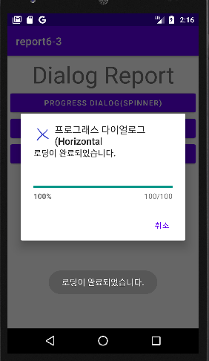
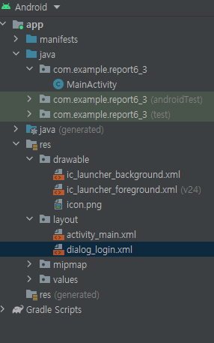
Report 3
package com.example.report6_3; import androidx.annotation.NonNull; import androidx.appcompat.app.AlertDialog; import androidx.appcompat.app.AppCompatActivity; import android.app.ProgressDialog; import android.content.Context; import android.content.DialogInterface; import android.os.Bundle; import android.os.Handler; import android.os.Message; import android.view.LayoutInflater; import android.view.View; import android.widget.Button; import android.widget.EditText; import android.widget.LinearLayout; import android.widget.Toast; public class MainActivity extends AppCompatActivity { Button button1; ProgressDialog progressDialog; @Override protected void onCreate(Bundle savedInstanceState) { super.onCreate(savedInstanceState); setContentView(R.layout.activity_main); button1=findViewById(R.id.button1); button1.setOnClickListener(new View.OnClickListener() { @Override public void onClick(View view) { progressDialog = new ProgressDialog(MainActivity.this); progressDialog.setMax(100); progressDialog.setIcon(R.drawable.icon); progressDialog.setTitle("프로그래스 다이얼로그(Horizontal"); progressDialog.setMessage("잠시만 기다려 주세요."); progressDialog.setButton(DialogInterface.BUTTON_NEGATIVE, "취소", new DialogInterface.OnClickListener() { @Override public void onClick(DialogInterface dialogInterface, int i) { Toast.makeText(MainActivity.this, "취소되었습니다.", Toast.LENGTH_SHORT).show(); }}); progressDialog.setProgressStyle(ProgressDialog.STYLE_HORIZONTAL); progressDialog.show(); new Thread(new Runnable() { @Override public void run() { try { while (progressDialog.getProgress() <= progressDialog.getMax()) { Thread.sleep(500); handler.sendMessage(handler.obtainMessage()); } } catch (Exception e) { e.printStackTrace(); } }}).start(); } Handler handler = new Handler(){ @Override public void handleMessage(@NonNull Message msg) { super.handleMessage(msg); progressDialog.incrementProgressBy(10); if (progressDialog.getProgress() >= progressDialog.getMax()) { progressDialog.setMessage("로딩이 완료되었습니다."); Toast.makeText(MainActivity.this, "로딩이 완료되었습니다.", Toast.LENGTH_SHORT).show(); } }};}); Button login = (Button)findViewById(R.id.loginBtn); login.setOnClickListener(new View.OnClickListener() { @Override public void onClick(View view) { showLoginDialog(); }}); } private void showLoginDialog() { LayoutInflater vi = (LayoutInflater) getSystemService(Context.LAYOUT_INFLATER_SERVICE); LinearLayout loginLayout = (LinearLayout) vi.inflate(R.layout.dialog_login, null); final EditText id = (EditText)loginLayout.findViewById(R.id.id); final EditText pw = (EditText)loginLayout.findViewById(R.id.pw); new AlertDialog.Builder(this).setTitle("커스텀 다이얼로그").setIcon(R.drawable.icon).setView(loginLayout).setPositiveButton("OK", new DialogInterface.OnClickListener() { @Override public void onClick(DialogInterface dialog, int which) { Toast.makeText(MainActivity.this, id.getText().toString() +" / "+ pw.getText().toString(), Toast.LENGTH_SHORT).show(); }}).show(); } public void onclick(View view) { ProgressDialog pd1 = new ProgressDialog(MainActivity.this); pd1.setIcon(R.drawable.icon); pd1.setTitle("프로그래스 다이얼로그(Spinner)"); pd1.setMessage("현재 진행중입니다."); pd1.setMax(100); pd1.setCancelable(false); pd1.setProgress(0); pd1.setProgressStyle(pd1.STYLE_SPINNER); pd1.setButton(DialogInterface.BUTTON_NEGATIVE, "Cancel", new DialogInterface.OnClickListener() { @Override public void onClick(DialogInterface dialog, int which) { Toast.makeText(MainActivity.this, "취소되었습니다.", Toast.LENGTH_SHORT).show(); }}); pd1.show(); } }
프로그래스 바 쓰레드에서 로딩이 완료되었습니다 토스트가 계속 출력되는데, 이유를 모르겠습니다. 자리도 바꿔보고 runOnUiThread까지 인터넷에서 찾아서 써봤는데도 출력이 정상적으로 되지 않아서 일단 올립니다.
<?xml version="1.0" encoding="utf-8"?> <LinearLayout xmlns:android="http://schemas.android.com/apk/res/android" android:layout_width="match_parent" android:layout_height="match_parent" style="@style/CardView.Dark" android:orientation="horizontal"> <LinearLayout android:layout_width="wrap_content" android:layout_height="match_parent" android:orientation="vertical"> <TextView android:layout_width="90dp" android:layout_height="45dp" android:layout_marginStart="16dp" android:text="ID" android:textSize="20sp" android:gravity="center"/> <TextView android:layout_width="wrap_content" android:layout_height="45dp" android:layout_marginStart="16dp" android:layout_gravity="center" android:text="PWD" android:textSize="20sp" android:gravity="center"/> </LinearLayout> <LinearLayout android:layout_width="wrap_content" android:layout_height="match_parent" android:orientation="vertical"> <EditText android:id="@+id/id" android:layout_width="150dp" android:layout_height="45dp" android:layout_marginStart="8dp"/> <EditText android:id="@+id/pw" android:layout_width="150dp" android:layout_height="45dp" android:layout_marginStart="8dp" android:inputType="numberPassword" /> </LinearLayout> </LinearLayout>
<?xml version="1.0" encoding="utf-8"?> <LinearLayout xmlns:android="http://schemas.android.com/apk/res/android" xmlns:tools="http://schemas.android.com/tools" android:layout_width="match_parent" android:layout_height="match_parent" android:orientation="vertical" android:padding="5dp" tools:context=".MainActivity"> <TextView android:layout_width="match_parent" android:layout_height="wrap_content" android:text="Dialog Report" android:gravity="center" android:textSize="20pt"/> <Button android:layout_width="match_parent" android:layout_height="wrap_content" android:onClick="onclick" android:text="Progress Dialog(Spinner)"/> <Button android:id="@+id/button1" android:layout_width="match_parent" android:layout_height="wrap_content" android:text="Progress Dialog(Horizontal Bar)"/> <Button android:id="@+id/loginBtn" android:layout_width="match_parent" android:layout_height="wrap_content" android:text="Custom Dialog"/> </LinearLayout>

Slide 5
예전부터 느낀건데, 개인적으로 안되는 것들이나 오류가 나는 것들이 있으면 이건 이렇게 해서 안된다 하고 조금 가르쳐주셨으면 좋겠어요.. 저희들이 많이 어려워해요.

